Slide 1
Microcontrollers
Part two of Review

Slide 2
Microprocessor
Intel: 8086, 80286, 80386, 80486, and Pentium
Motorola: 68000, 68010, 68020, 68030, 68040

Slide 3
Microprocessor
On the chip
No RAM; No ROM; No I/O ports;
Intel: 8086, 80286, 80386, 80486, and Pentium
Motorola: 68000, 68010, 68020, 68030, 68040

Slide 4
Microcontrollers
Microchip, Motorola, Zilog, Atmel, Dallas Semiconductor:
Based on 8051
Family members of 8051: 8052 and 8031
Texas Instruments: based on 8751
Renesas: M34501 Motorola: 68HC16Z3
Sharp: LH79520

Slide 5
Microcontroller
CPU
+ RAM + ROM
+ I/O ports + Timers + ...
On the Chip

Slide 6
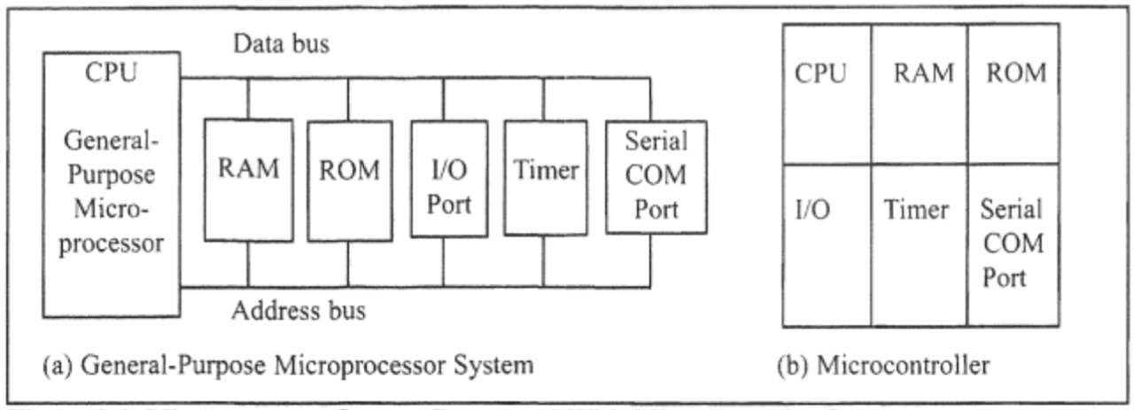

Slide 7
𝞵Cs vs 𝞵Ps (other diffs)
smaller
cost and space are critical
computing power needs are less
power and price per unit

Slide 8
8051 Microcontroller
Internal Architecture

Slide 9
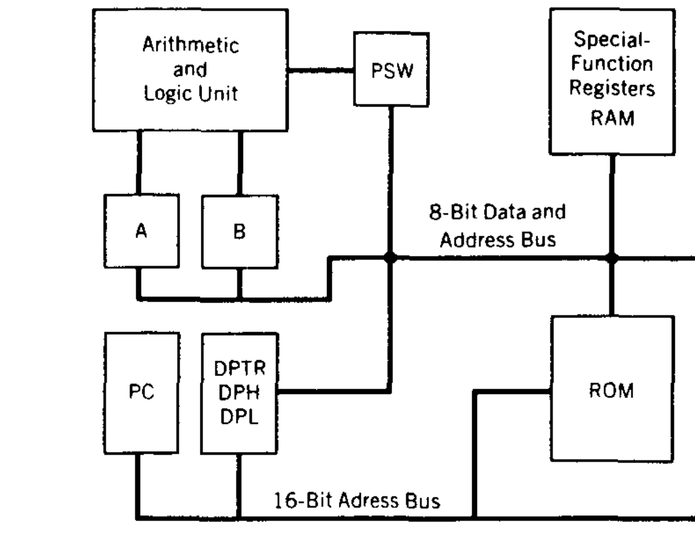
Block Diagram of 8051

Slide 10
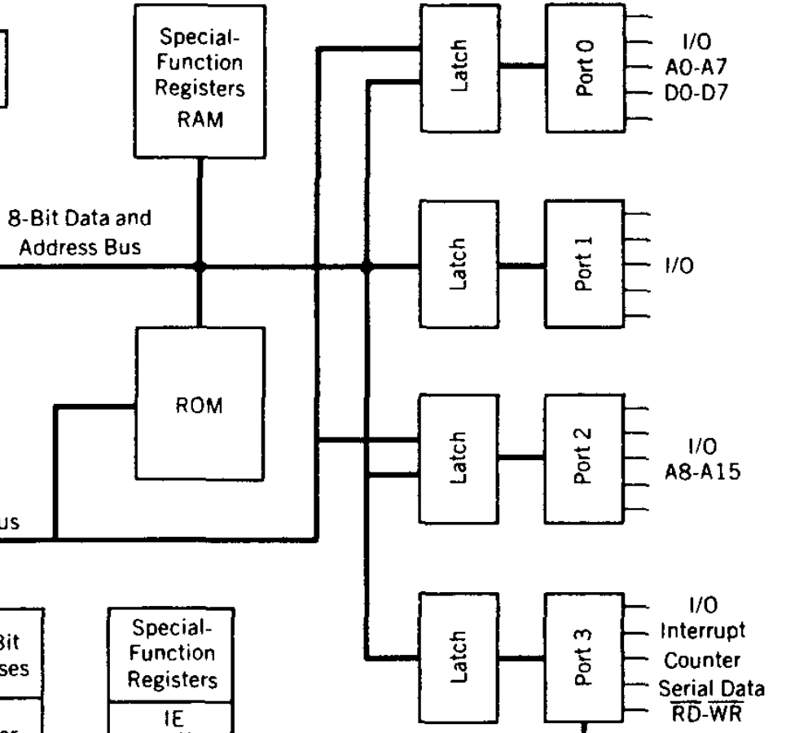
Block Diagram of 8051

Slide 11
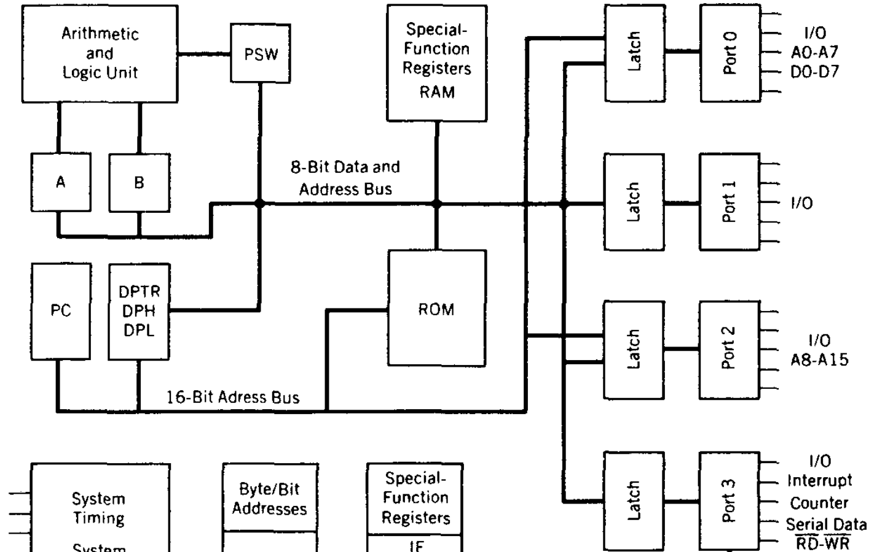
Block Diagram of 8051

Slide 12
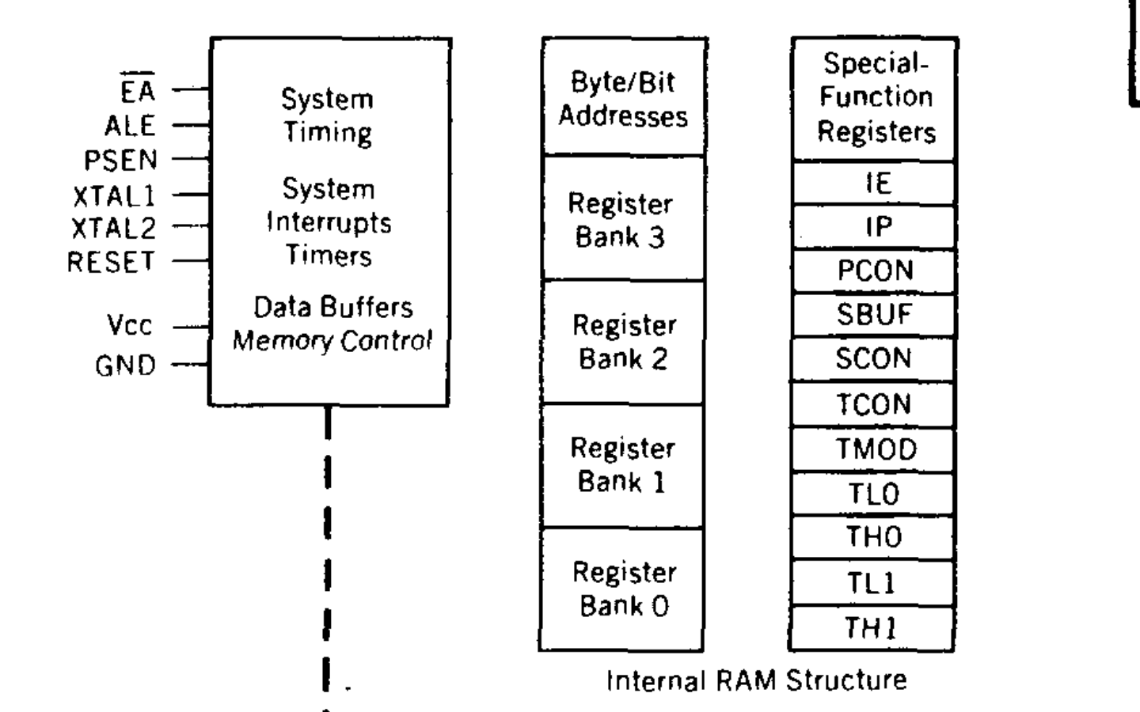
Block Diagram of 8051

Slide 13
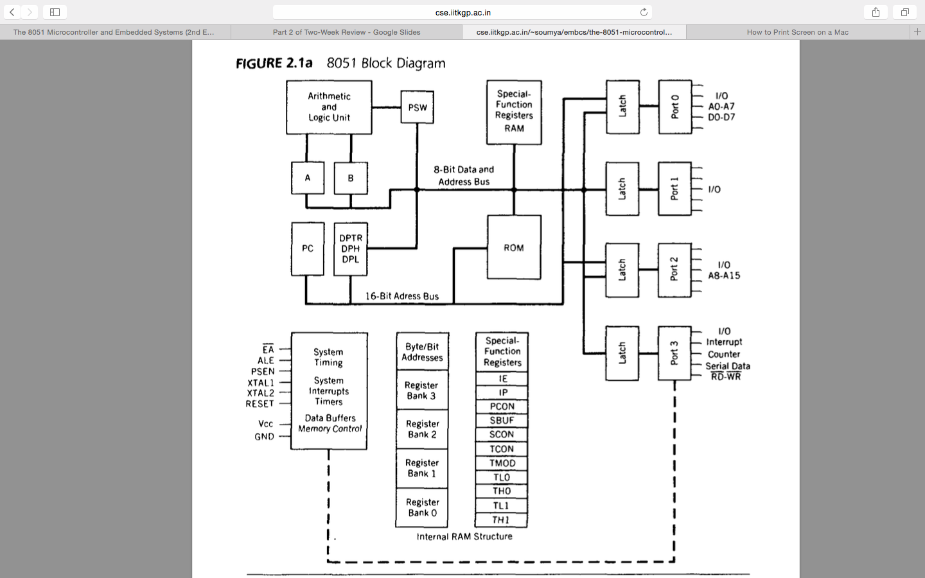
8051 Block Diagram

Slide 14
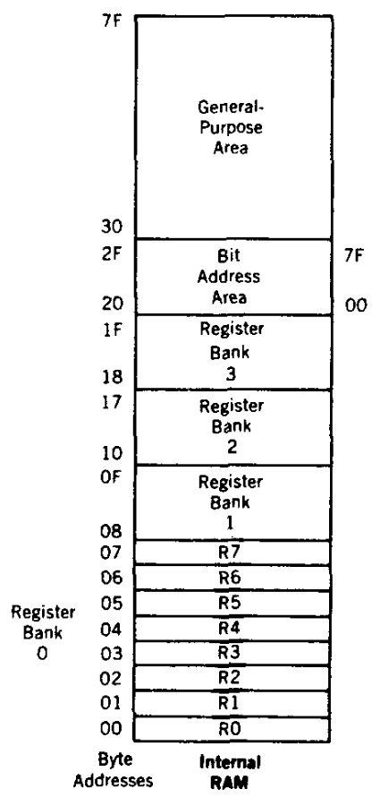
Internal RAM

Slide 15
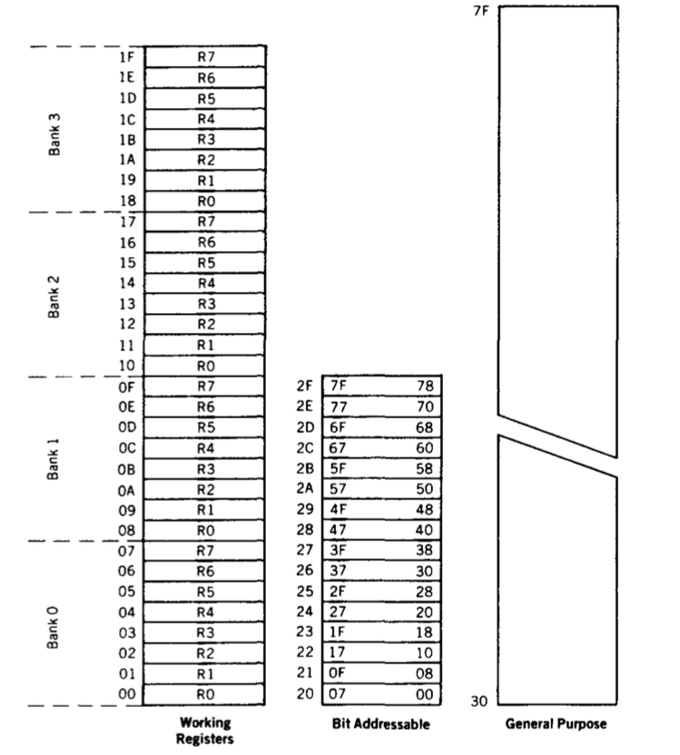
Internal RAM
Organization

Slide 16
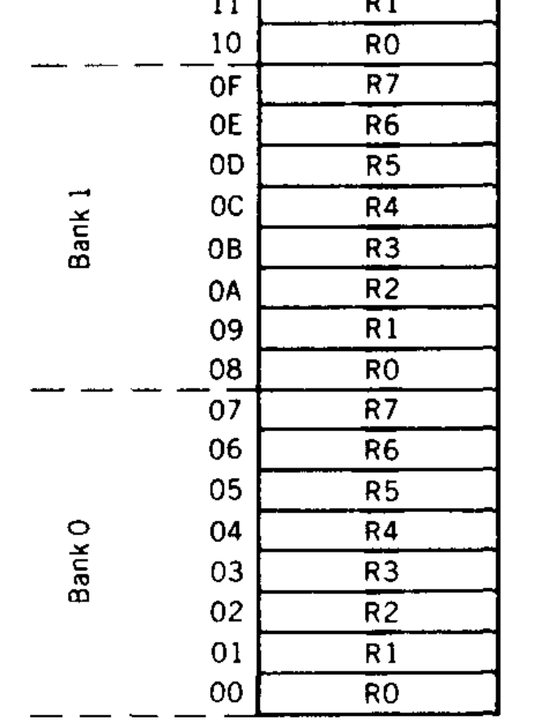
Internal RAM
Organization
- Register Banks

Slide 17
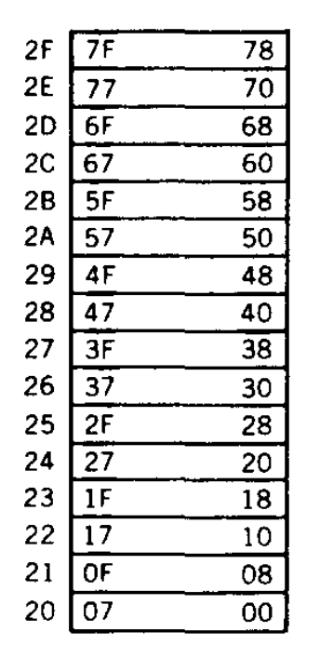
Internal RAM
Organization
Bit/Byte Addressable Area

Slide 18
Internal RAM
Organization

Slide 19
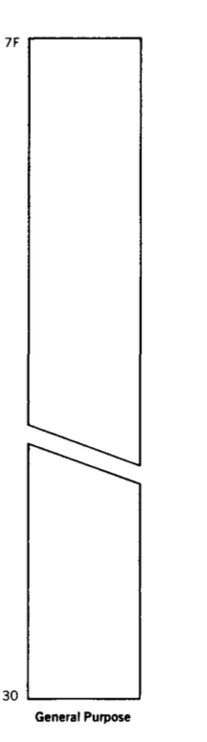
Internal RAM
Organization
General Purpose

Slide 20
FFF
Internal ROM
000

Slide 21
Data/Program Architecture
8051 is Harvard architecture
Program and data memory are different
8051 uses the same address for code and data
Internal circuitry access the correct memory based on the nature of operation

Slide 22
Mini Project
Guidelines

Slide 23
Purpose
To understand Embedded Systems theory better than learning without doing projects.

Slide 24
Plan A
Other
Plans

Slide 25
Plan A - Overview
Use Keil Software Evaluation Version.
Write small C programs and/or
Understand a large C program, “Measure”

Slide 26
Plan A- (Pending) Issues
Limitation of the Keil Evaluation Tool Version.
But you can download the tool to your Windows PC.

Slide 27
Plan A - Success Strategy
Step-by-Step Introduction in the class to do a project using Keil MicroVision Software

Slide 28
Other Plans
EdX Course

Slide 29
Other Plans
Free RTOS

Slide 30
Other Plans
Simple Scalar Processor Simulator

Slide 31
Other Plans
SystemC

